Slide 1
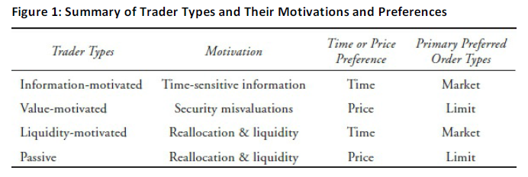
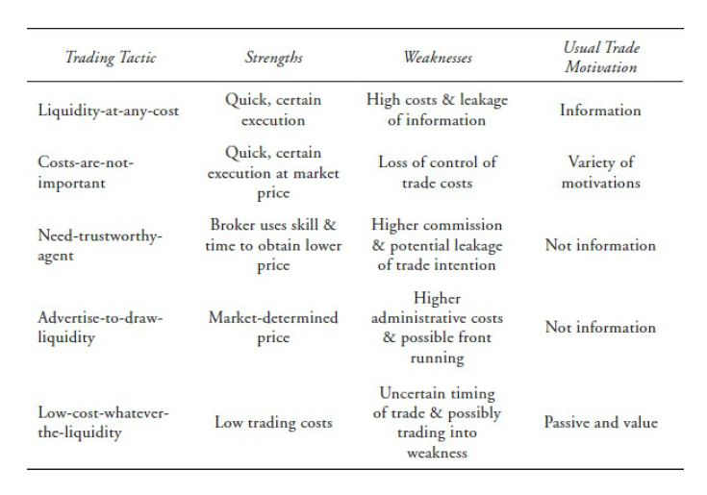
Ch: 31: Execution of Portfolio Decisions

Slide 2
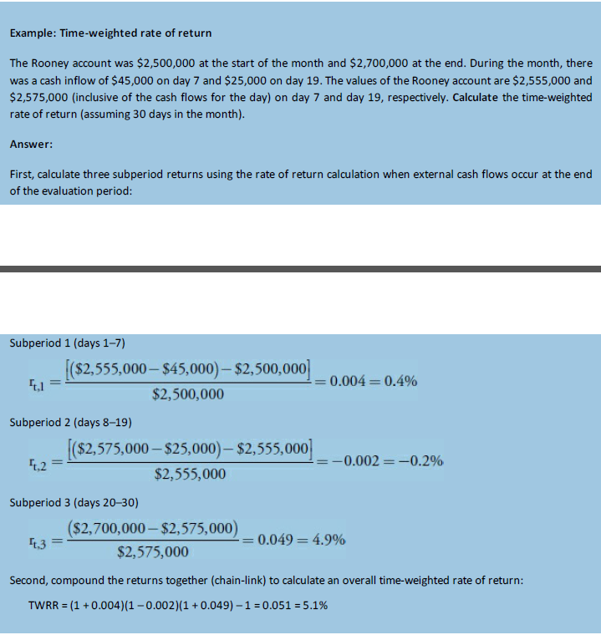
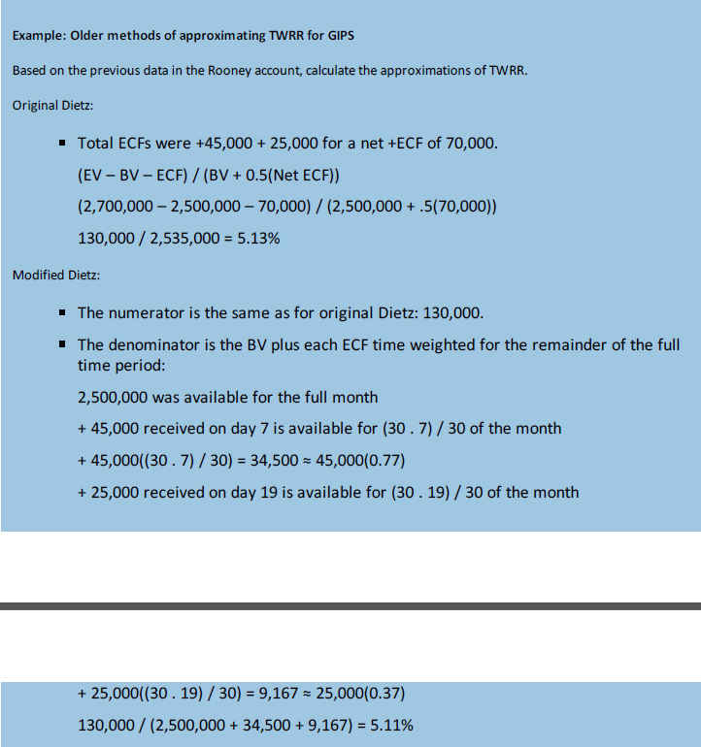
Ch: 34: GIPS

Slide 3
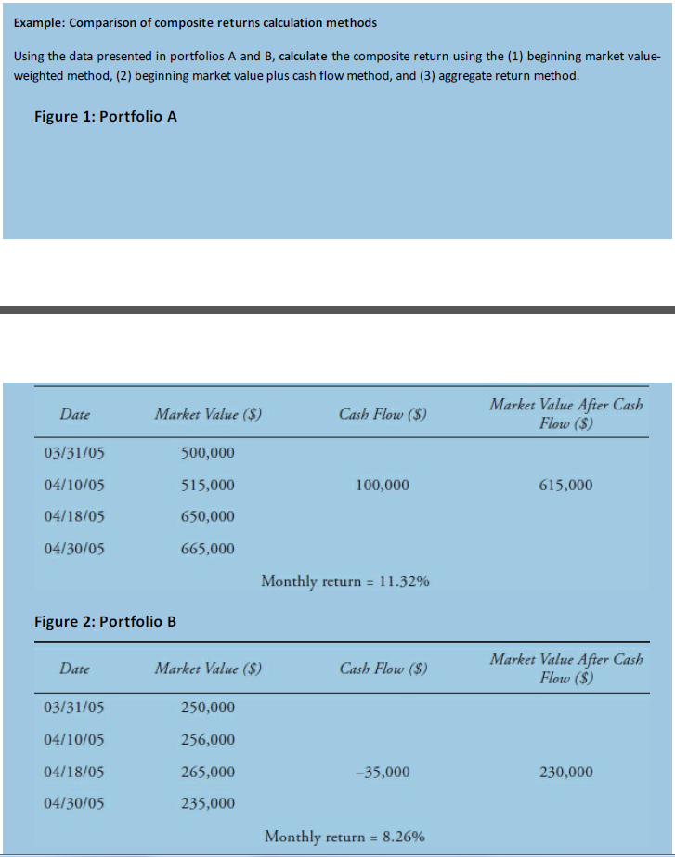
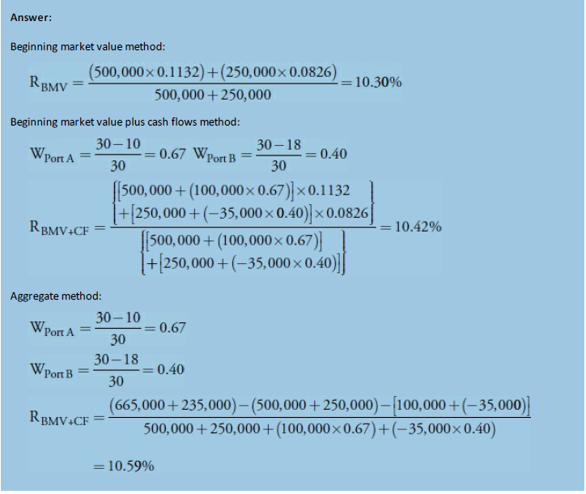
Ch: 34: GIPS

Slide 4
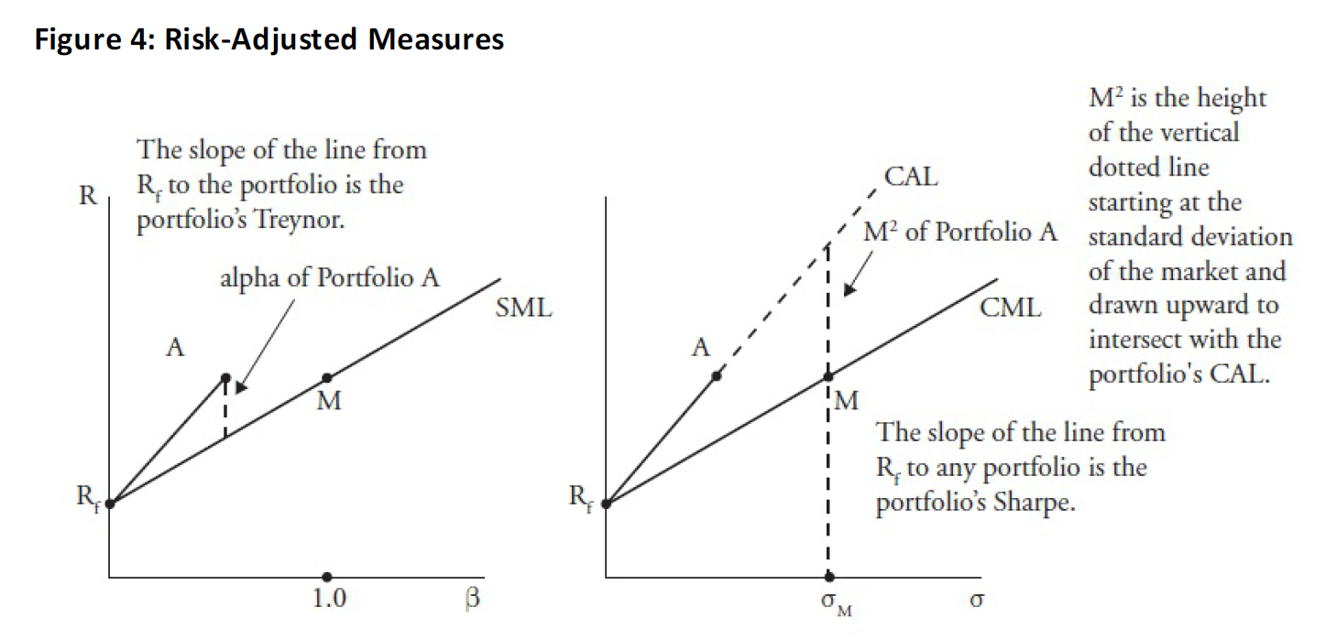
Ch: 31: Evaluating portfolio performance

Slide 5
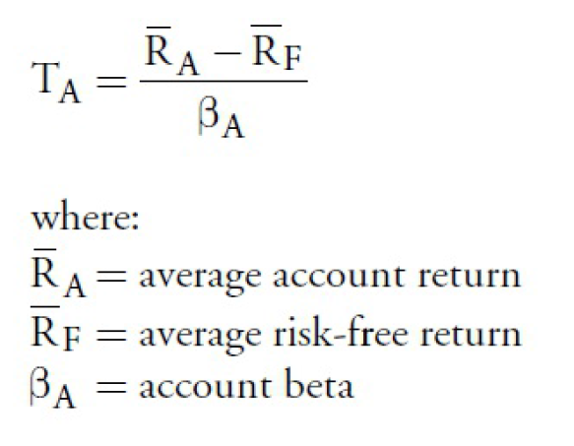
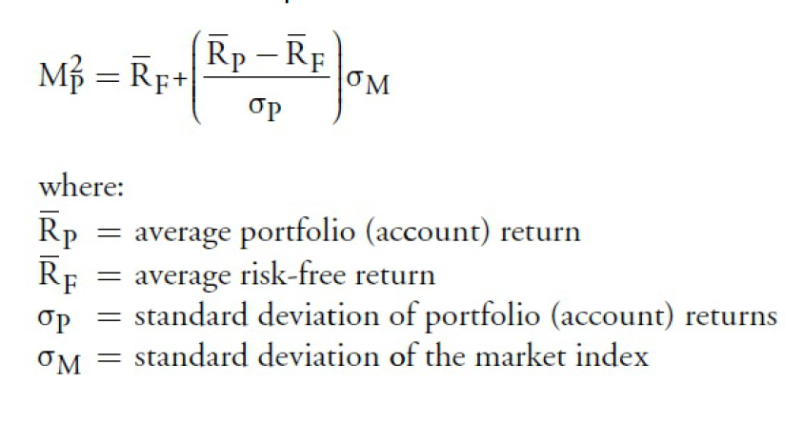
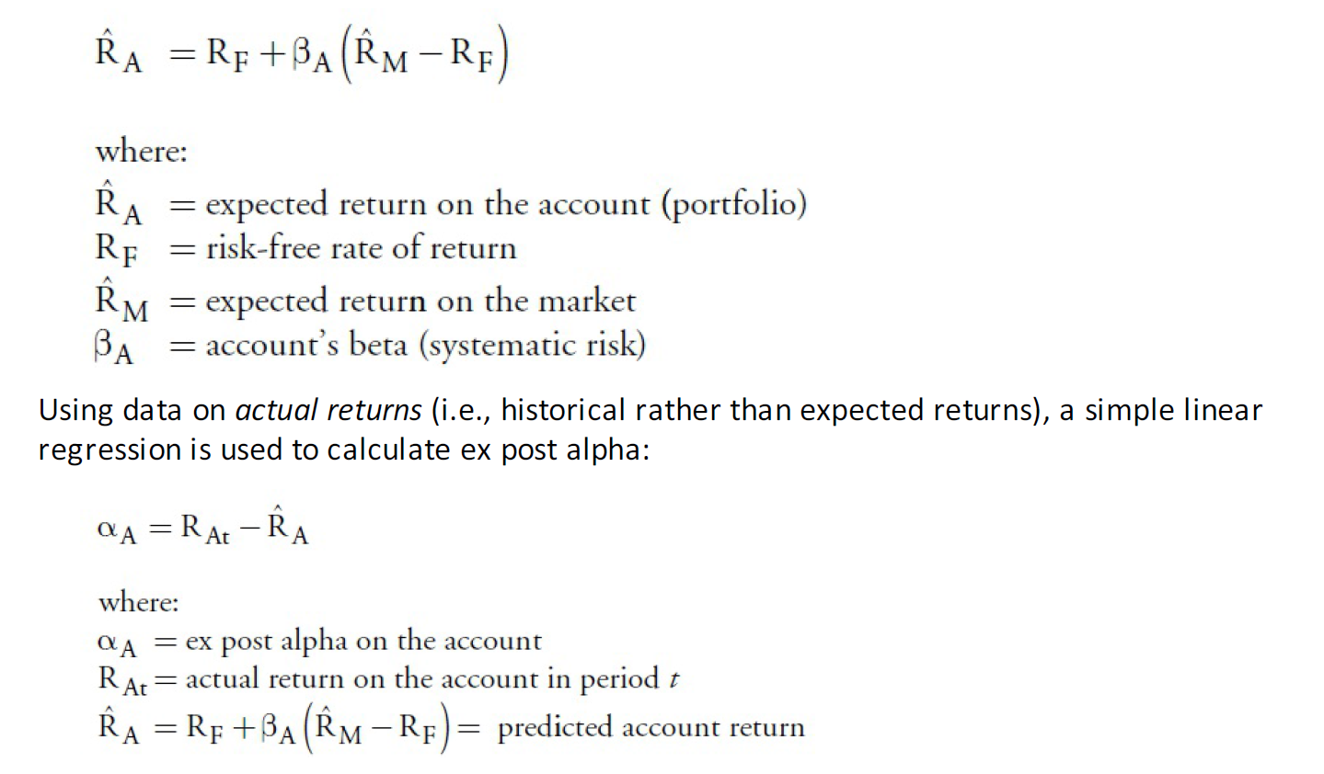
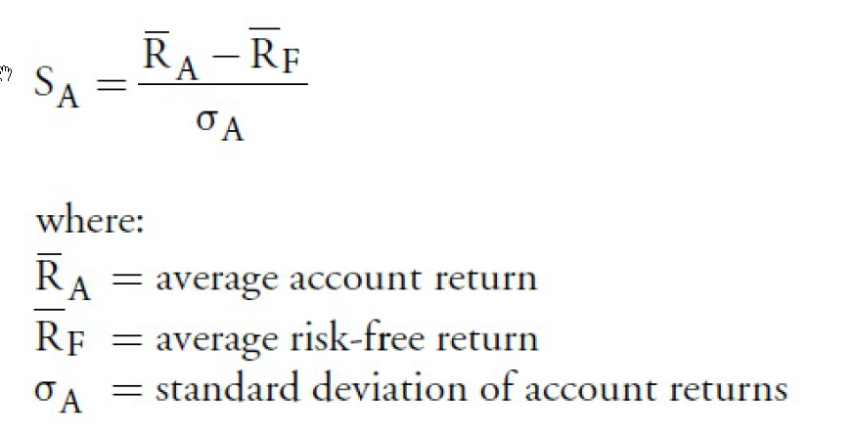
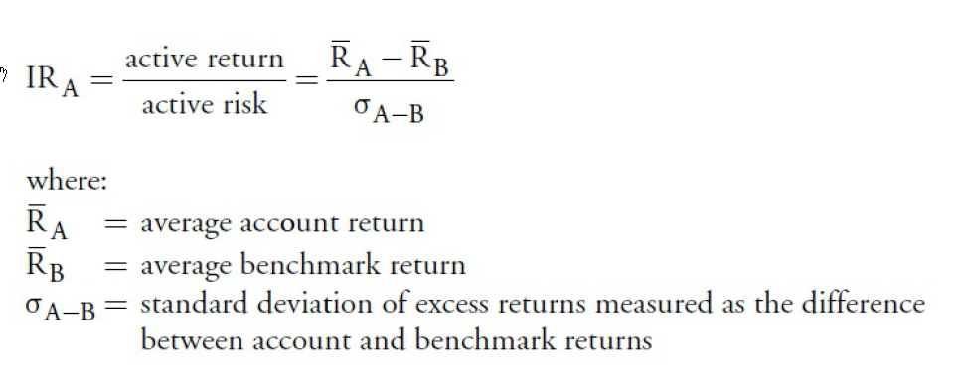
Ch: 31: Evaluating portfolio performance

Slide 6
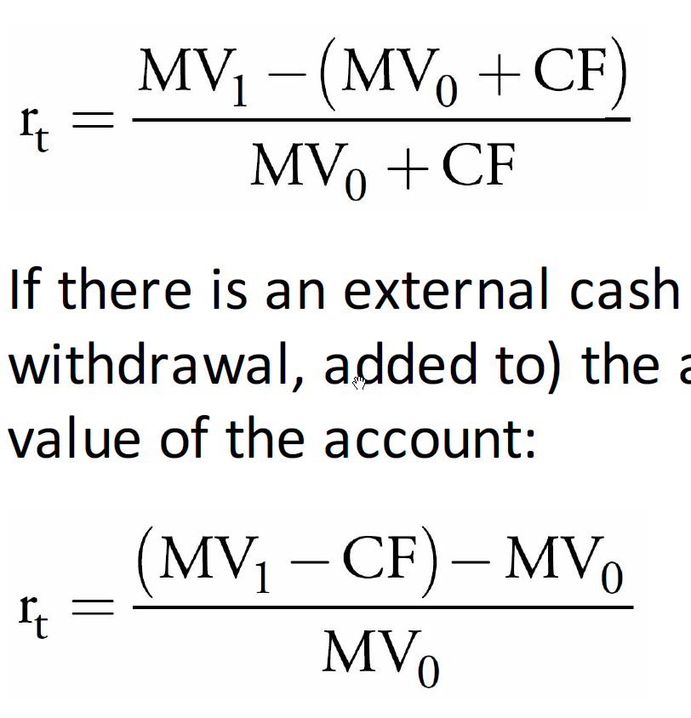
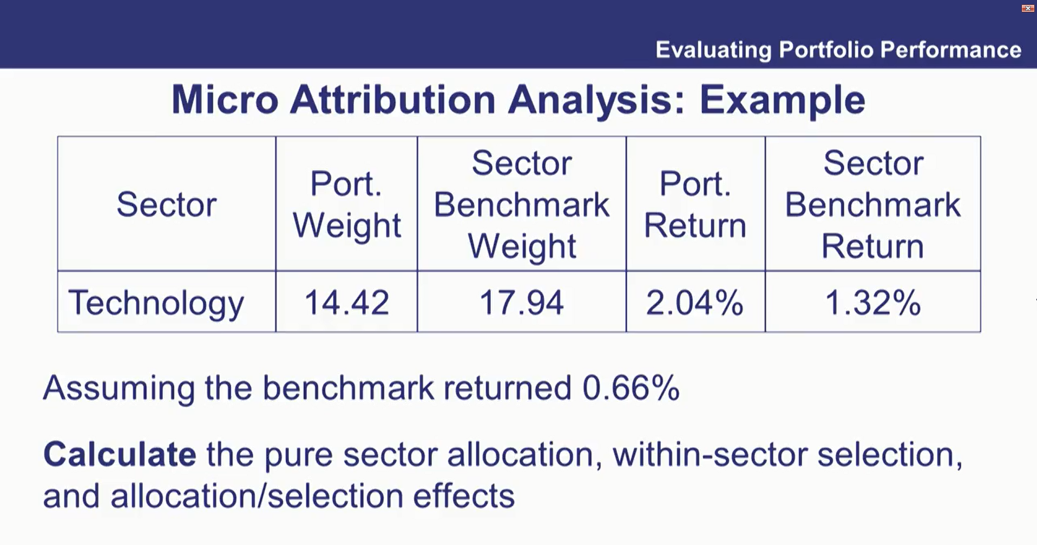
Ch: 31: Evaluating portfolio performance

Slide 7
Rebalancing Strategy | Rebalancing execution | Does best in market | Market impact if popular | Floor of portfolio value vs. initial value, post-rebalancing | Investor appropriateness if risk tolerance
Buy and hold | Do nothing | None | N/A | Same | Increases and decreases with wealth. RT reaches zero at floor
Constant Mix | Constantly rebalance back to the initial allocation weights. A mean-reverting strategy. | Mean reverting | Creates market stability | Less | Independent of wealth RT reaches zero at floor (but no floor in CM rebalancing)
Constant Proportion (Portfolio Insurance) | If the risky asset allocation increases (decreases), buy more (less). A momentum strategy. | Simple trending | Creates market volatility | Greater | High risk tolerance RT reaches zero at floor

Slide 8
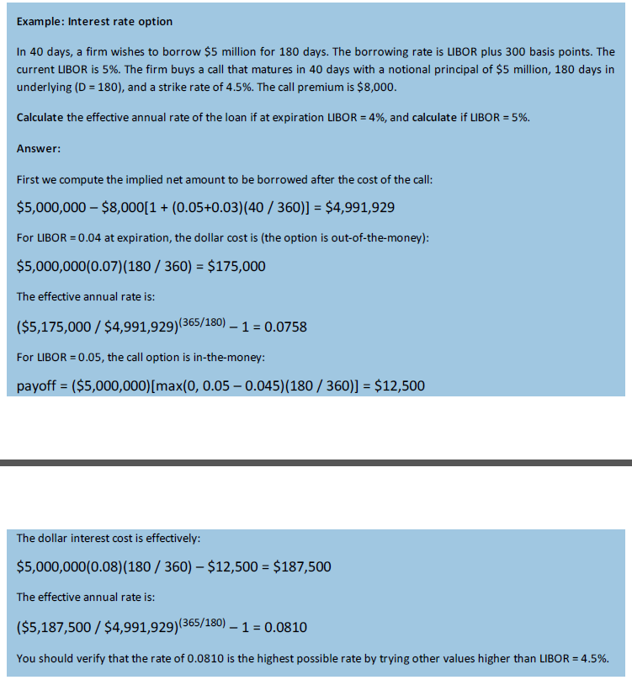
Ch: 29: Risk Mgmt using Options

Slide 9
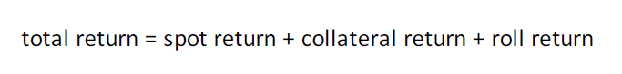
Ch: 26: Risk Mgmt using Options

Slide 10
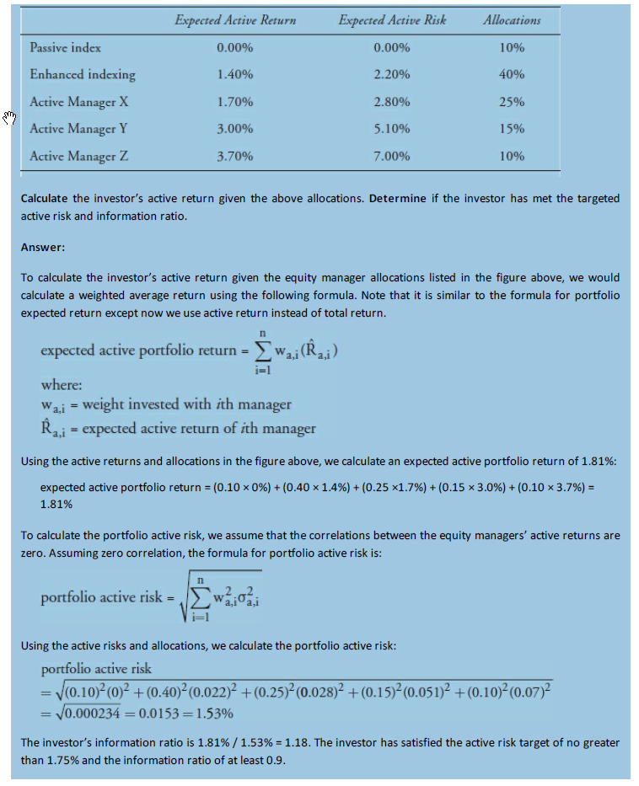
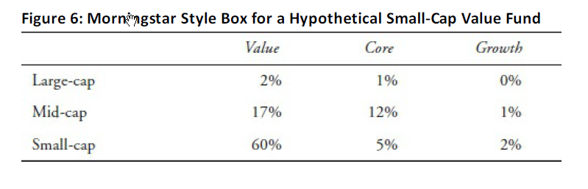
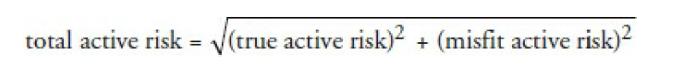
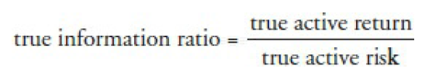
Ch: 25: Equity portfolio mgmt

Slide 11
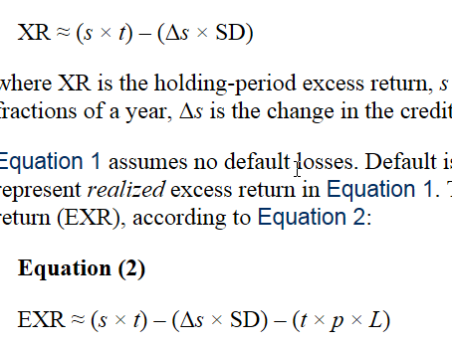
Ch: 24 Fixed Income Active Mgmt: Credit Strategies

Slide 12
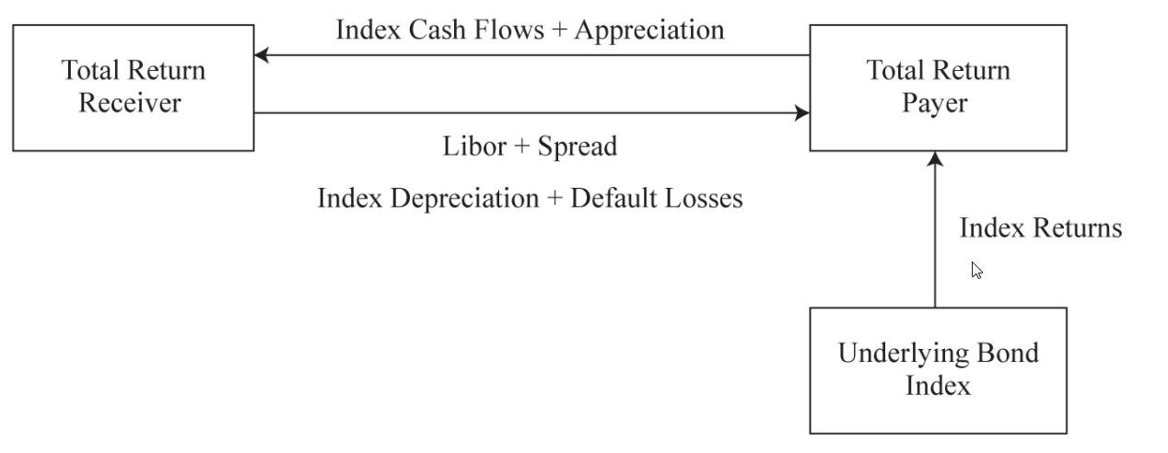

Slide 13
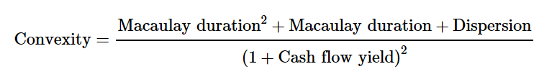
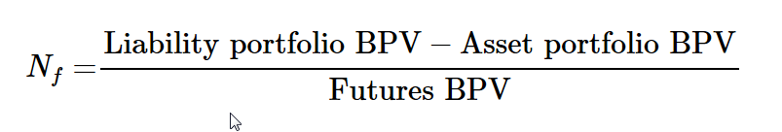
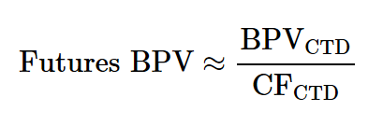
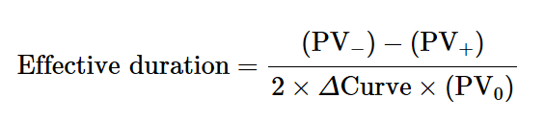
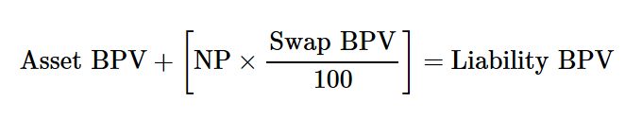

Slide 14
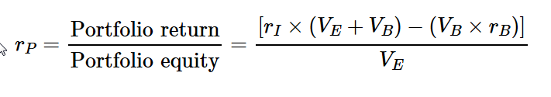
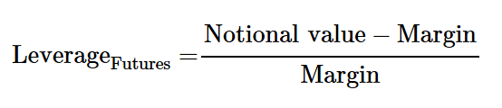

Slide 15
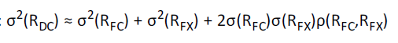
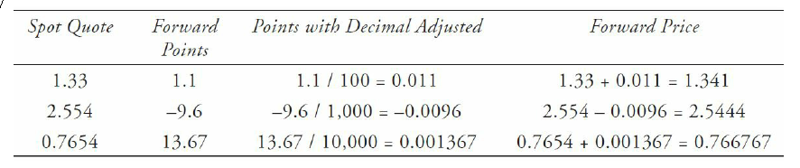
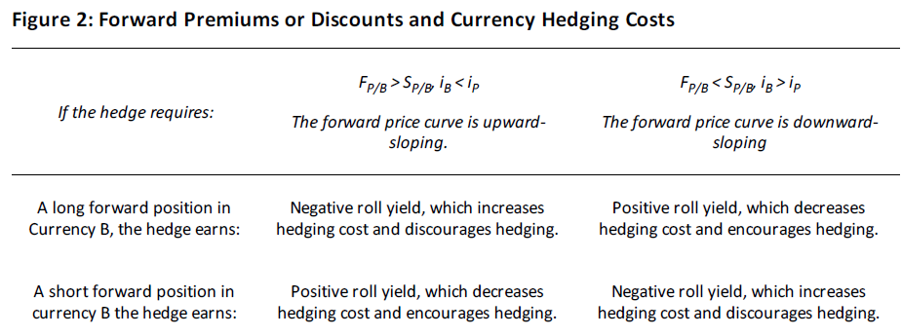

Slide 16
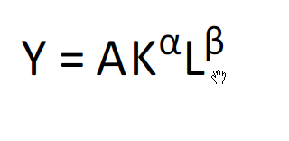
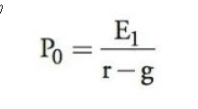
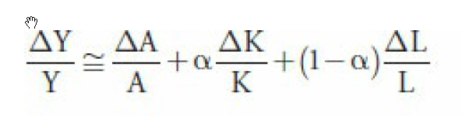
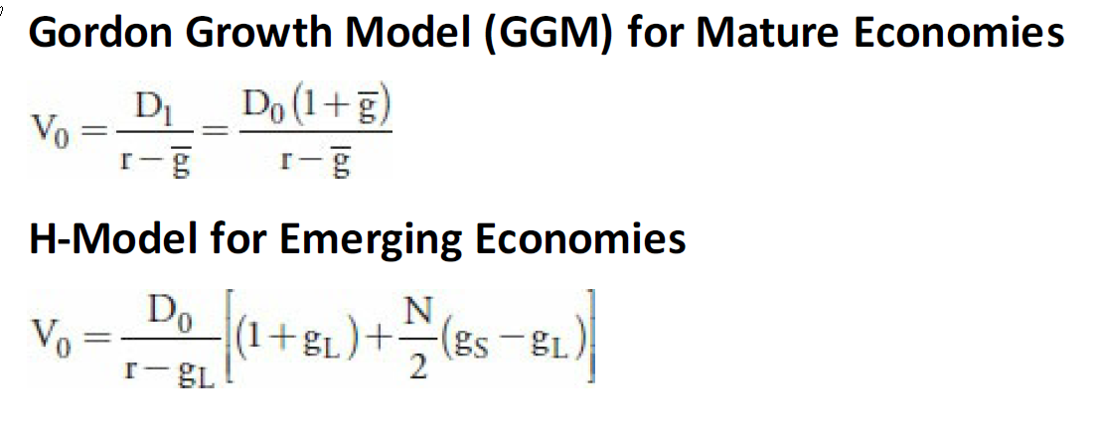
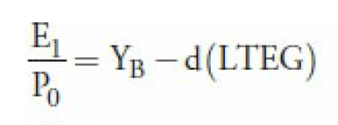
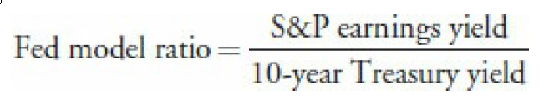

Slide 17

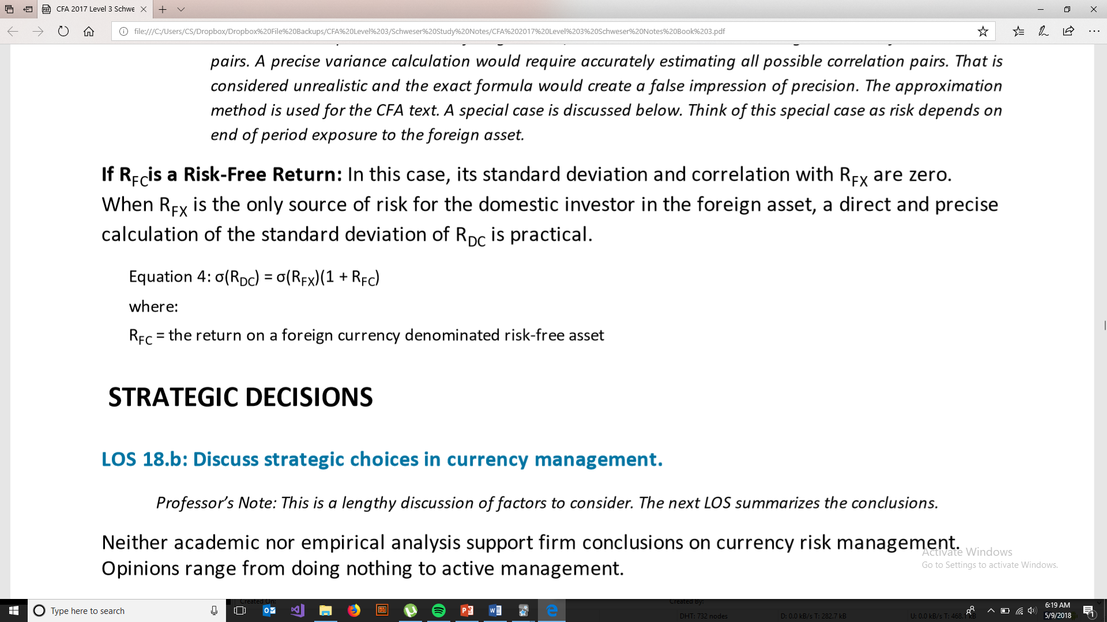

Slide 18
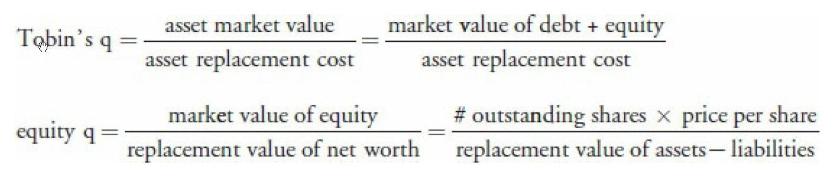

Slide 19
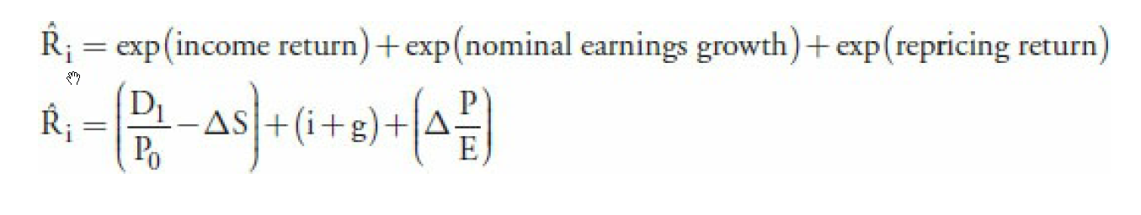
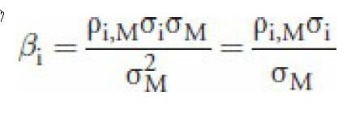
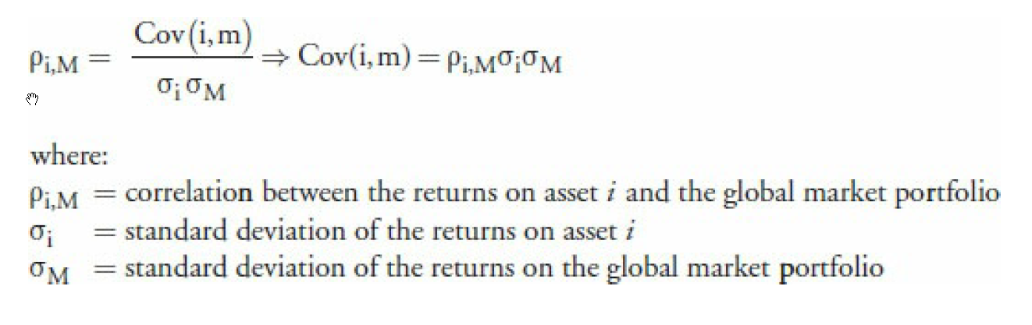
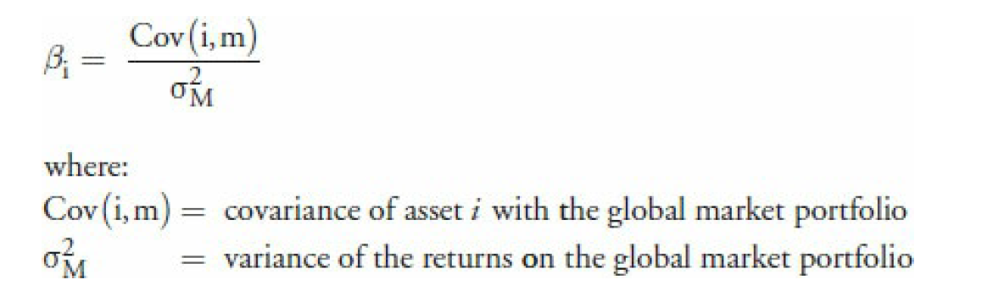

Slide 20
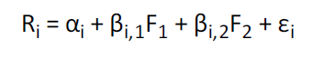
Ch 14: Capital Market Expectations

Slide 21
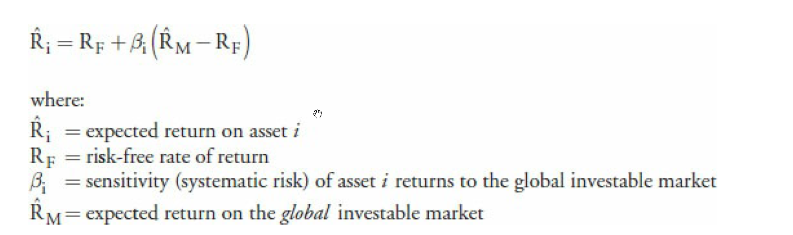

Slide 22
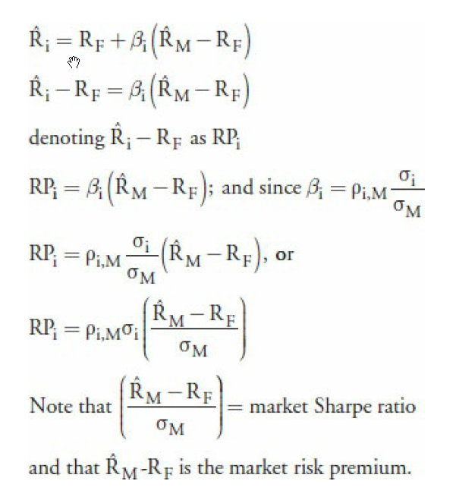
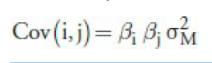

Slide 23
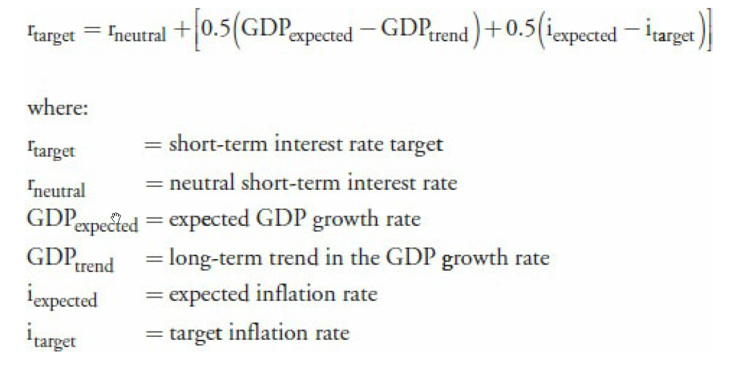

Slide 24
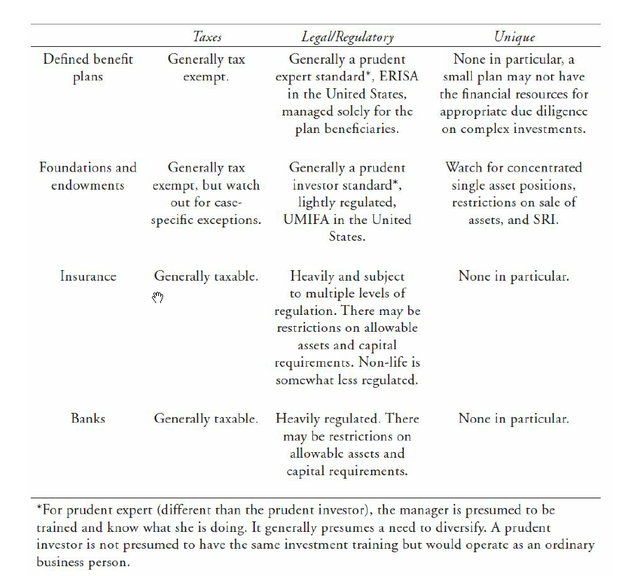


Slide 25


Slide 26



Slide 27







Slide 28


Slide 29


Slide 30

Chapter 9: Taxes. Diffs btw accrual, capital gains, and periodic wealth taxes.

Slide 31


Slide 33
Bias / Error | Symptom | Mitigant
Conservatism bias | Market participants rationally form an initial view, but then fail to change that view as new information becomes available | Become aware of own biases
Confirmation bias | Market participants look for new information or distort new information to confirm an existing view | Seek out contrary views and information
Representativeness | Market participants believe that the past will persist and new information is classified based on past experience or classification | Start with better understanding of laws of probability and statistical analysis
Illusion of control bias | Market participants think they can control or affect outcomes when they cannot | Realize that investment results are probabilistic
Hindsight bias | Market participants have a selective memory of past events, actions, or what was knowable in the past | Start by asking questions like “Do I really remember what I predicted and recommended?”
Anchoring and adjustment bias | Market participants select an arbitrary initial value to estimate an unknown, and make changes in relation to the initial view (i.e., “anchor point”), instead of objectively considering new data. | Start with asking questions such as “Do I continue to recommend this stock because I like the previous price I recommended, or am I open to an analysis process like the first time?”
Mental accounting | Market participants treat money differently based on how they categorize it | Examine what the portfolio could have achieved if the entire client assets were examined as one portfolio considering the effects of correlation among ALL parts of the whole
Framing bias | Market participants allow the way in which questions or data is “framed” to influence their decisions | Ask questions such as “Is my decision based on realizing a gain or a loss?”
Availability bias | Market participants place undue emphasis on the information that is readily available, solely for convenience purposes | Maintain a carefully researched and constructed Investment Policy Statement (IPS) through appropriate research and analysis of all decisions, and a long term focus
Loss-aversion bias | Market participants feel more pain from a loss than pleasure from an equal gain | Maintain a disciplined, well-thought out process based on future prospects of an investment, not perceived gain or loss
Overconfidence bias | Market participants overestimate their own intuitive ability or reasoning | Establish long-term financial goals with a budget to assure adequate savings and investments are made to meet all goals
Self-control bias | Market participants lack self-discipline and favor immediate gratification over long-term goals | Establish an appropriate investment plan and a budget to achieve sufficient savings
Status quo bias | Market participants allow their comfort with the existing situation to maintain their existing choices | Hard to overcome. Education re. reasonable risk/return combinations and the dangers of overconcentration is essential
Endowment bias | Market participants feel that an asset is special and more valuable, outside of the sole merits of its performance | Start a disciplined diversification program
Regret-aversion bias | Market participants do nothing out of excess fear that actions could be wrong | Communicate effectively the benefits of diversification, the risk / return trade offs, and the consequences of not meeting critical long-term investment goals

Slide 34


